Slide 1
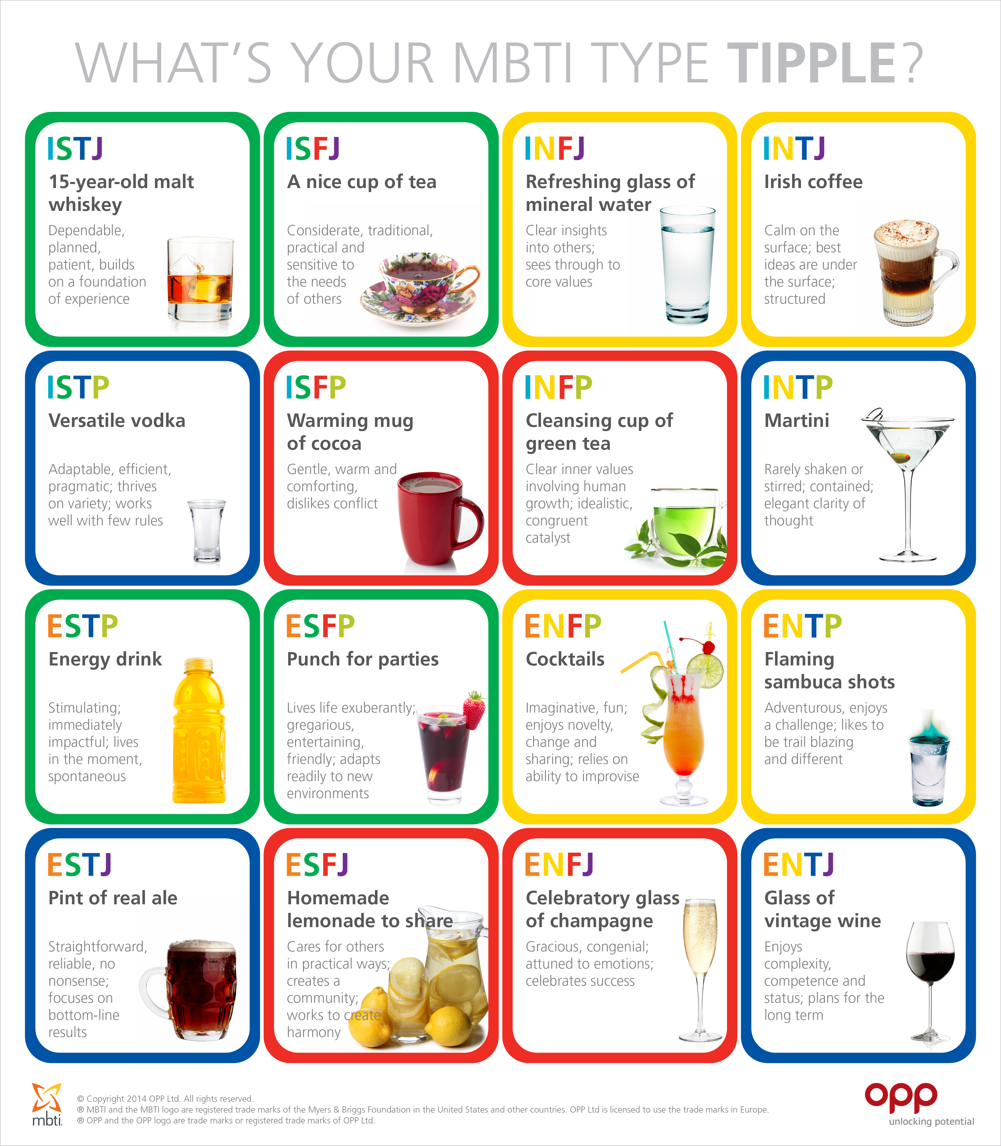
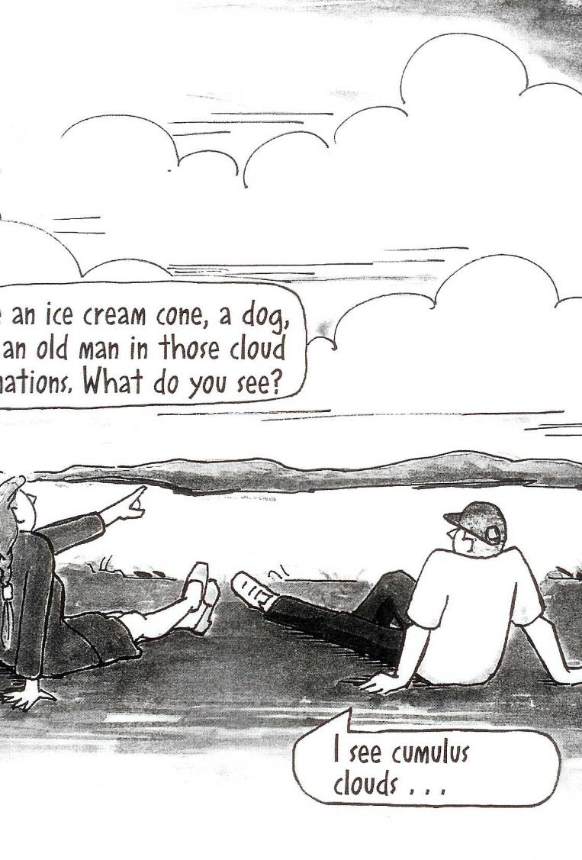
Type Dynamics
Megan Davies, Deputy Head of Careers and Employability
Rod Furnish, Careers & Employability Consultant
October 2017

Slide 2
Today’s session
By the end of this workshop you will be able to…
understand different team roles
discuss effective communication styles
analyse differences in personality and working styles
appreciate personality preferences and the impact of personality on communicating and working with others
contribute effectively to your teams’ success.

Slide 3
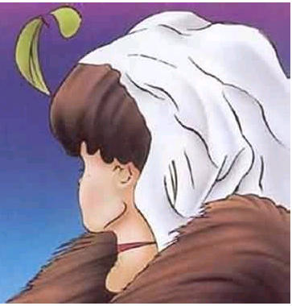
What do you see?
Notes:
What do you see here?
Young woman or old lady?

Slide 4
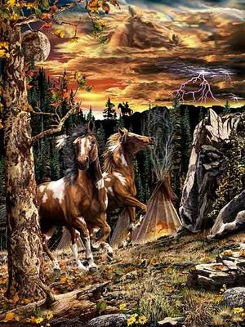
How many horses are in this picture?
Notes:
How many horses do you see in this picture?

Slide 5
How many horses are in this picture?
There are (at least) 11
Notes:
How many horses do you see in this picture?
What you see affects how you approach things.

Slide 6

A group of people = different personalities
Notes:
A bit of a jigsaw - Strip away experience and skills and ultimately the success of a team relies on a group of different personalities, working together to achieve a goal. Understanding your own and others’ behaviour within a team will help you to develop your teamwork style.

Slide 7
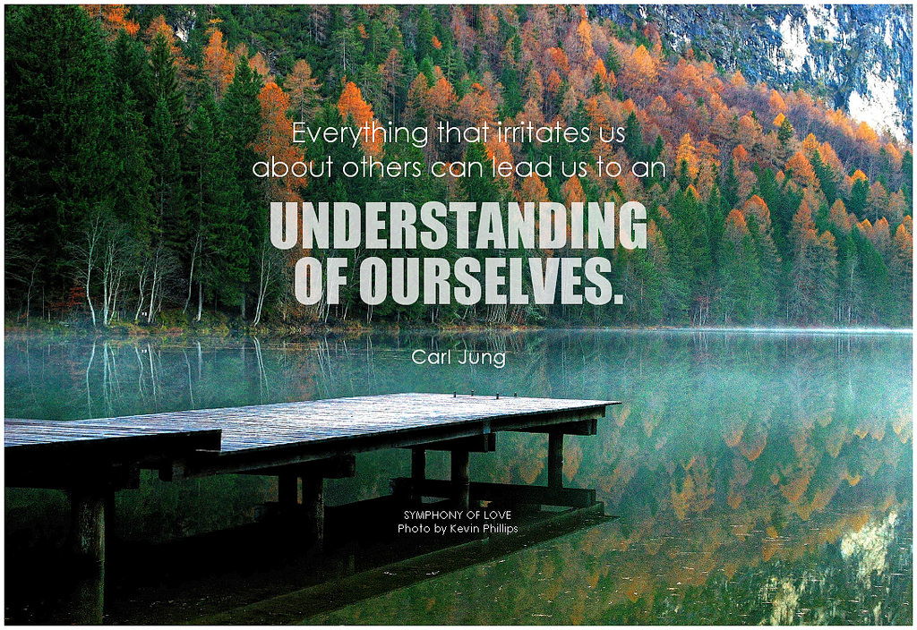

Slide 8
Frustrations of teamwork/group work
People who appear:
not to let others speak
not to say anything
to pick fault with everything
not to think about detail
to be insensitive to others
overly emotional
to be rigid and inflexible
disorganised
Notes:
What are the frustrations for you?
Were they being awkward or is was it because of who they are that they acted like that?

Slide 9
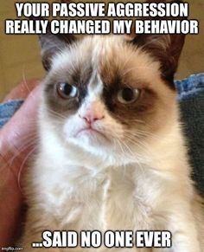
There is no excuse for bad behaviour….
but there may be explanations for
differences in behaviour…..

Slide 10
What is a preference?
Write your signature on a piece of paper.
Now do it again with the OTHER hand!
My name

Slide 11
The concept of ‘preference’
“Natural”
“Easy”
“Flowing”
“Comfortable”
“Took less Energy”
“Unnatural”
“Difficult”
“Jerky”
“Awkward”
“Took more Energy”

Slide 12
Basic assumptions of type theory
The TDI questionnaire assesses preferences.
Preferences are not absolutes: everyone uses all eight.
Preferences are not abilities: TDI preferences do not tell you what you can and can’t do.
There are no better or worse types: all types have potential.
People are the best judges of their own type – hence the TDI questionnaire is an indicator, not a test.

Slide 13
A 3-stage process
1.questionnaire 2.self assessment
3.your ‘best fit’
You are the best judge of your personality!
Notes:
Completed the questionnaire: You will be looking at your outcomes later.
Moving onto self assessment after a brief explanation of the framework.
Best fit – you decided – based on q results and this afternoon’s self assessment exercises.

Slide 14
The four dimensions of type
Where you prefer to get and focus your ‘energy’ or attention
Extraversion | XandX | Introversion
Sensing | XandX | iNtuition
Thinking | XandX | Feeling
Judging | XandX | Perceiving
What kind of information you prefer to gather and trust
What process you prefer to use in coming to decisions
How you prefer to deal with the world around you, your ‘lifestyle’

Slide 15
Terminology
Extraversion/ Not about social confidence or
Introversion social skill
Sensing Not the same as ‘sensitive’
Intuition Not ‘woman’s intuition’
Not ‘gut feeling’
Thinking Thinkers have feelings and emotions
Feeling Feelers can think and are rational
Not about emotion
Judging Not ‘judgmental’
Perceiving Not ‘perceptive’
Notes:
It is important to dispel layman’s meanings, and ensure that every preference is seen as equally valuable.

Slide 16
Discussion topic
“Should all students pay tuition fees?”

Slide 17
The four dimensions of type
Extraversion | XandX | Introversion
Sensing | XandX | iNtuition
Thinking | XandX | Feeling
Judging | XandX | Perceiving
Where you prefer to get and focus your ‘energy’ or attention
What kind of information you prefer to gather and trust
What process you prefer to use in coming to decisions
How you prefer to deal with the world around you, your ‘lifestyle’

Slide 18
The four dimensions of type
Extraversion | XandX | Introversion
Where you prefer to get and focus your ‘energy’ or attention

Slide 19
People who prefer:
Extraversion
Get energy from the outer environment of people and experiences
Focus energy and attention outwards in action
Introversion
Get energy from the inner environment of reflections and thoughts
Focus energy and attention inwards in reflection

Slide 20
Characteristics
Extraversion vs
Do-think-do vs
Action vs
Talk things through vs
Expressive vs
Interaction vs
Breadth of interest vs
Introversion
Think-do-think
Reflection
Think things through
Contained
Concentration
Depth of interest

Slide 21
How Es/Is might view each other
Introversion can sometimes be seen as: Being deliberately silent and not willing to contribute | Alternatively: Calm, thoughtful, working out the right thing to do
Extraversion can sometimes be seen as: Annoying, noisy, preventing others from speaking | Alternatively: Open, vocal, gets things moving

Slide 22
What is your preference?
While everyone can operate in both modes, we do not prefer them equally.
E ? I
Very sure Quite sure Not sure Quite sure Very sure
Notes:
How clear are you about your preference on this dimension?
Any questions?

Slide 23
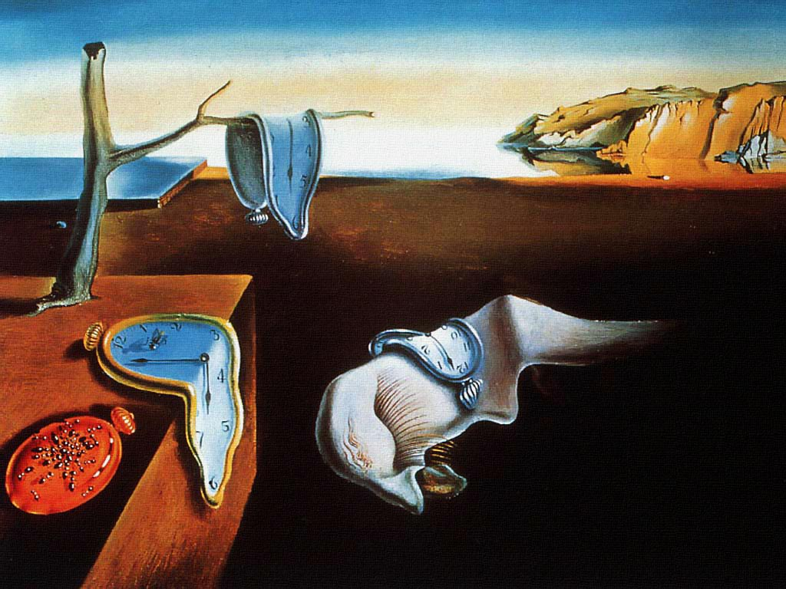

Slide 25
Tell me about the picture

Slide 26
What do you see?
See the pattern/associations, then specifics?
See the specifics, then the pattern/associations?
Notes:
What do you see here?

Slide 27
The four dimensions of type
Sensing | XandX | iNtuition
What kind of information you prefer to gather and trust

Slide 28
People who prefer:
Sensing
Prefer information coming from the five senses
Focus on what is real
Value practical applications
iNtuition
Prefer information coming from association
Focus on what might be
Value imagination and insight

Slide 29
How S/Ns might view each other
iNtuition may be seen as | Needed to:
Sensing may be seen as: | Needed to:
Vague and Impractical
Difficult to follow
Head in the clouds
Envisage the future
Offer radical ideas
Fault-picking
Pessimistic
Unimaginative
Remind them of facts
Be realistic
Notes:
S – on a day when you are feeling particularly
uncharitable how would you describe Ns
N – ditto S

Slide 30
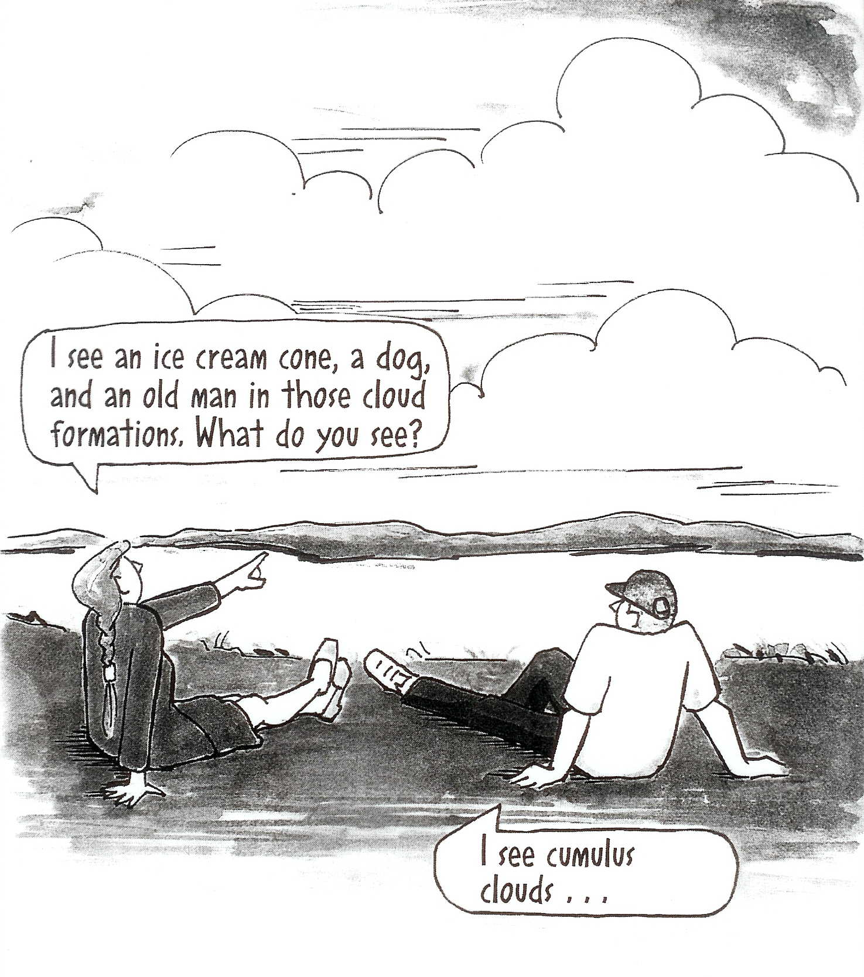
Sensing-INtuition
Notes:
30
How do you take in information?
If you have a preference for sensing, you are comfortable with what is real, concrete, factual. You use your senses and rely on experience. You focus on the present
If you have a preference for intuition, you work by making patterns and seeing connections and meanings behind or inside the facts. You use and trust your inspiration and focus on the future.

Slide 31
Scenario
Your friend rings you:
“Someone’s broken into my room”
How would you respond?

Slide 32
The four dimensions of type
Thinking | XandX | Feeling
What process you prefer to use in coming to decisions

Slide 33
People who prefer:
Thinking
Prefer to make decisions on the basis of logic and objectivity
Quick to see errors and give a critique
Step out of situations in order to analyse dispassionately
Feeling
Prefer to make decisions on the basis of values and personal convictions
Quick to show appreciation and find common ground
Step into situations to weigh human values and motives

Slide 34
Characteristics
Thinking vs
Guided by cause-and-effect reasoning vs
Logical analysis vs
Seek objective truth vs
Impersonal criteria vs
Critique vs
Focus on task vs
Feeling
Guided by personal values
Understand others’ point of view
Seek harmony
Personal circumstances
Praise
Focus on relationship

Slide 35
How Ts/Fs might view each other
T may see F as: | T needs F to:
F may see T as: | F needs T to:
Illogical
Overly emotional
Be in touch with feelings
To persuade and reconcile
Critical
Insensitive
Be tough
Weigh costs and benefits

Slide 36
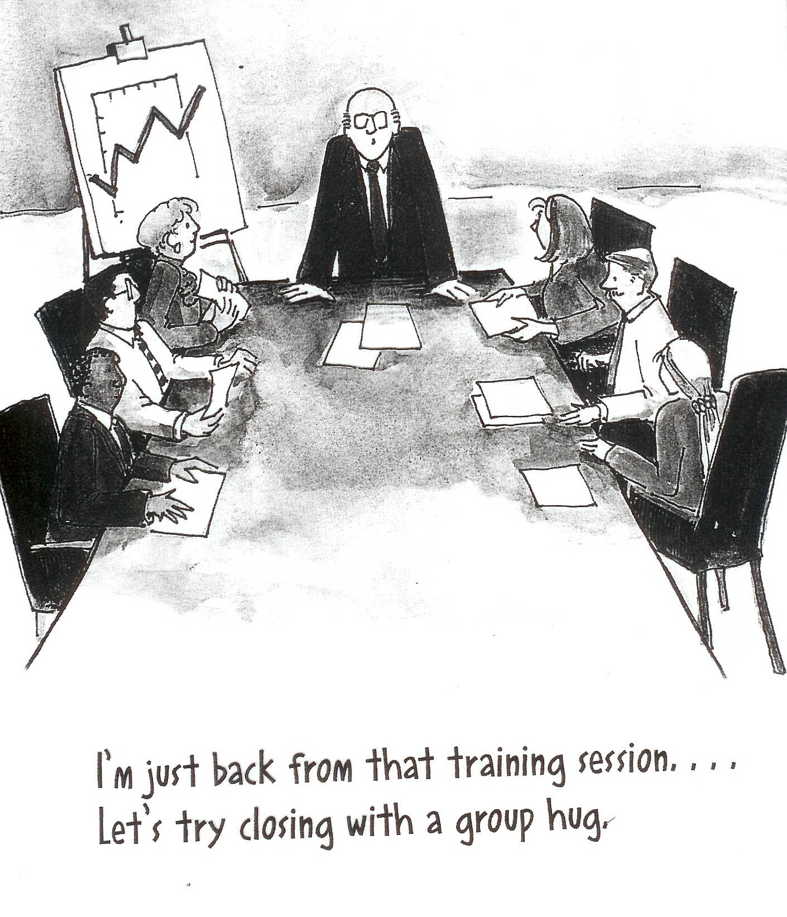
Thinking-Feeling
Notes:
36
How do you make decisions?
If you prefer thinking, you are concerned with the logical consequences and are comfortable with objective analysis. Fairness means equal treatment for everyone. Your goal is an objective standard of truth.
If you prefer feeling, you are concerned with effects on people and comfortable with subjective, value-based consideration. Fairness means treating everyone as an individual. Your goal is harmony.
This cartoon is perhaps not so directly related as the others, but the activity we’re doing later looks at another aspect of the thinking-feeling dimension so we have chance to think about it again.
Participants to mark on self assessment form
-------------------------------------------------------------------
MOVING ON TO THE NEXT ACTIVITY FOR J-P: PUT WORK/PLAY STATEMENTS ON WALLS
Participants should stand nearest to the statement which suits them best, but may feel they want to be in the middle. Discuss situations of work and play etc with people nearby to see if you need to swap places or move

Slide 37
Lifestyle
Go and stand by the statement you agree with
Discuss with those around you why you chose that statement
What do you think of those you prefer the other end of the line?
I must finish my work before I can play
I can play any time

Slide 38
Lifestyle
Imagine:
You have a project to complete and it is due 30 days from today.
It will take <24 hours to complete.
Line up on day 1-30 in terms of when you would start
What do you think of those you prefer the other end of the line?
Day 1
Day 30

Slide 39
The four dimensions of type
How you prefer to deal with the world around you, your ‘lifestyle’
Judging | XandX | Perceiving

Slide 40
People who prefer:
Judging
Prefer to live life in a planned and organised manner
Enjoy coming to closure and being decisive
Avoid stressful last-minute rushes
Perceiving
Prefer to live life in a spontaneous and adaptable manner
Enjoy keeping options open and being curious
Feel energised by last-minute pressures

Slide 41
Characteristics
Judging vs
Planned vs
Organised vs
Controlled vs
Structured vs
Scheduled vs
Perceiving
Emergent
Flexible
Unconstrained
Go with the flow
Spontaneous

Slide 42
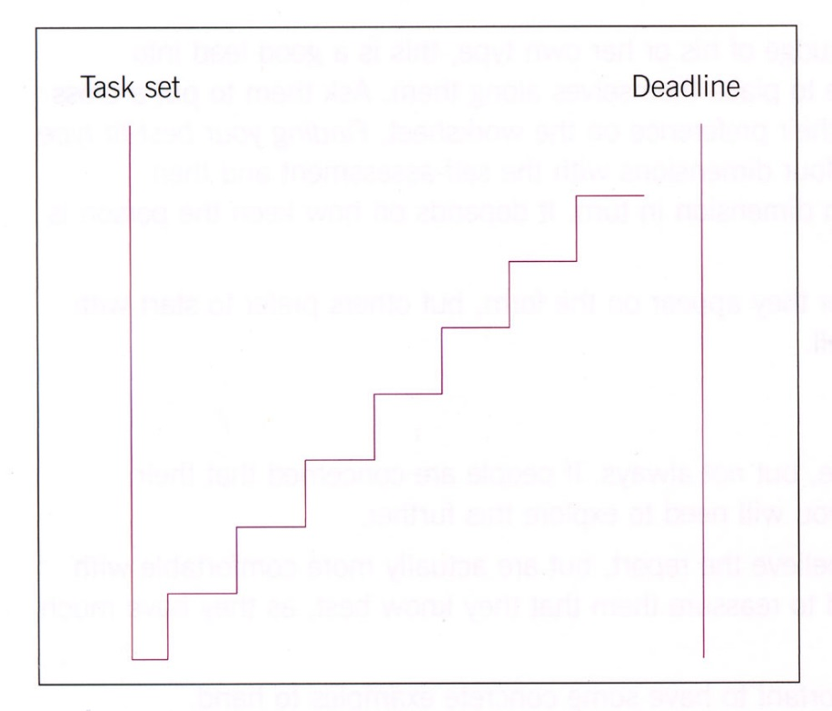
Approaches to planning
J
P
Notes:
A person who prefers Judging will work in a methodical way, perhaps ticking off milestones to demonstrate progress.
A person who prefers Perceiving may take longer to search for information and will be triggered into action by an impending deadline. NB: Click once and the PowerPoint will draw all the lines for P automatically.

Slide 43
How Js/Ps might view each other
Perceiving types may be seen as: | Needed for:
Judging types may be seen as: | Needed for:
Disorganised
Irresponsible
Adaptability
Information gathering
Rigid and inflexible
Overly serious
Organisation
Completion

Slide 44
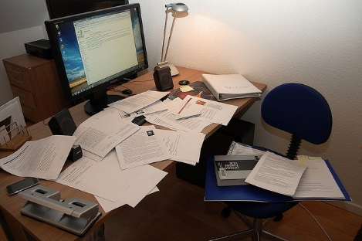
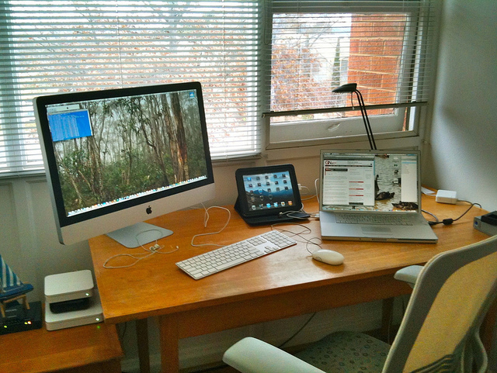
Who’s is whose?

Slide 45
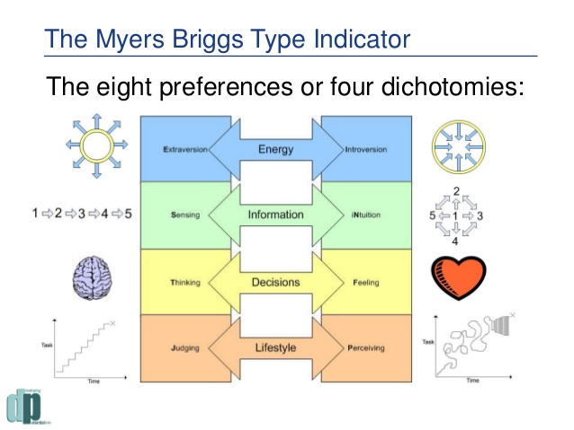
In summary

Slide 46
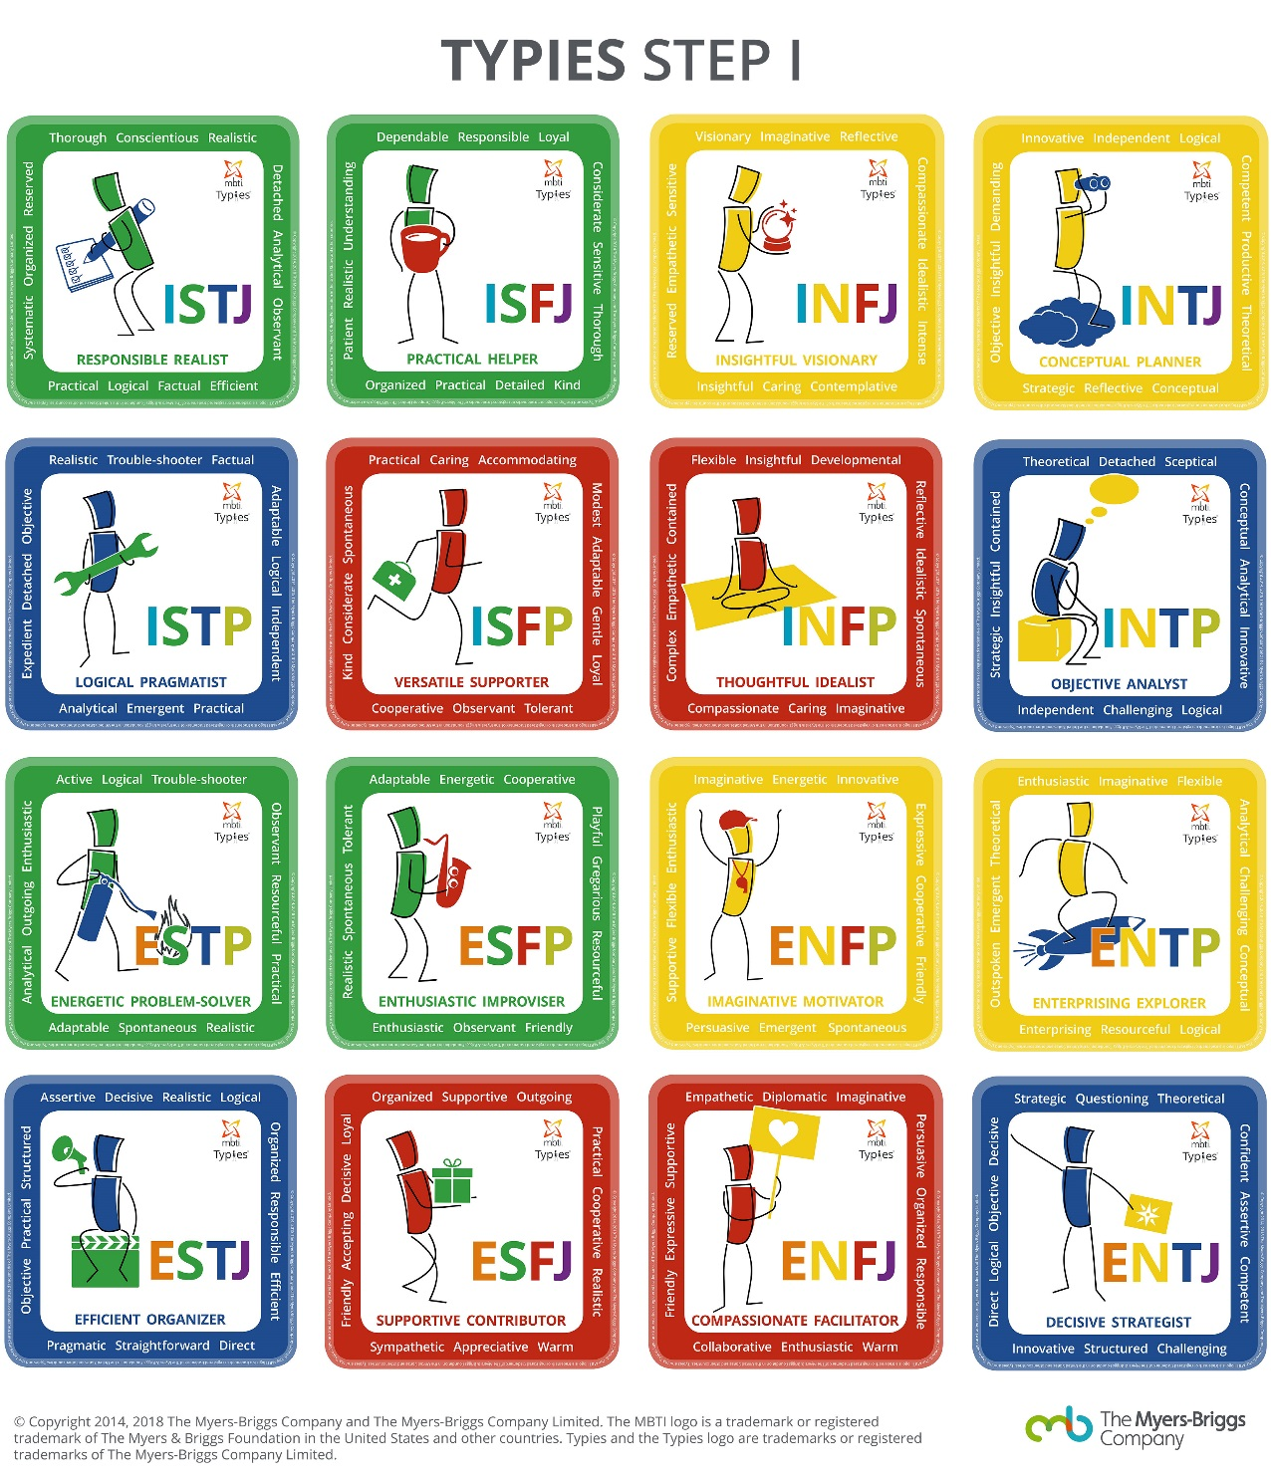
Put it all together…
https://eu.themyersbriggs.com/en/Using-Type/MBTI-Step-I-Typies

Slide 47
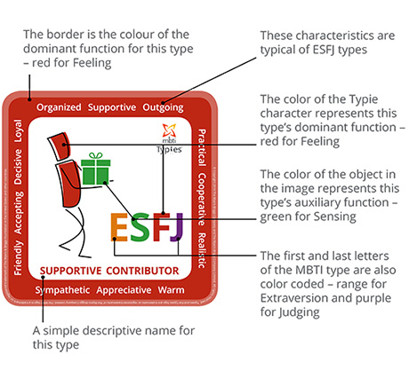
https://eu.themyersbriggs.com/en/Using-Type/MBTI-Step-I-Typies

Slide 48
Put it all together…
October 2017

Slide 49
Implications
Communication
Leadership
Problem Solving
Etc…………
During:
- your course
- job recruitment processes
- in work

Slide 50


Slide 51

Feedback

Slide 52
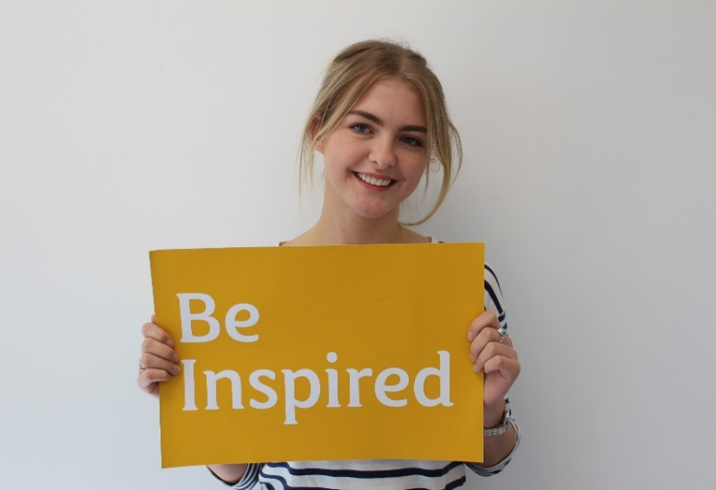
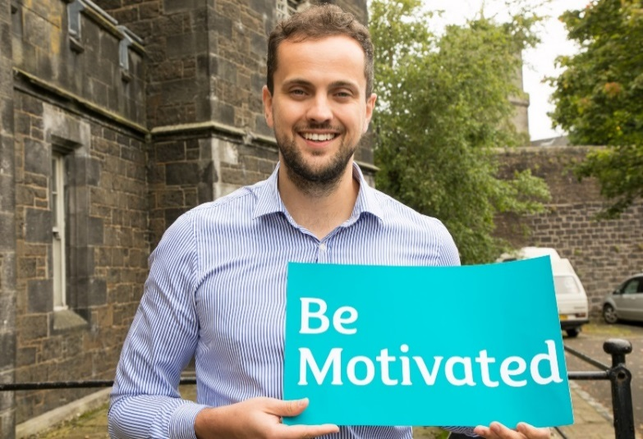
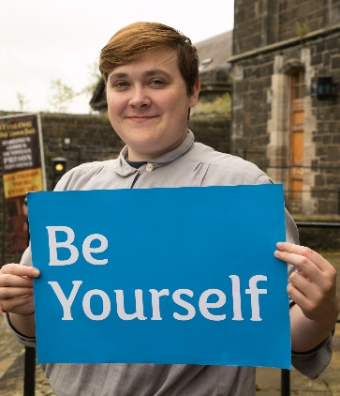
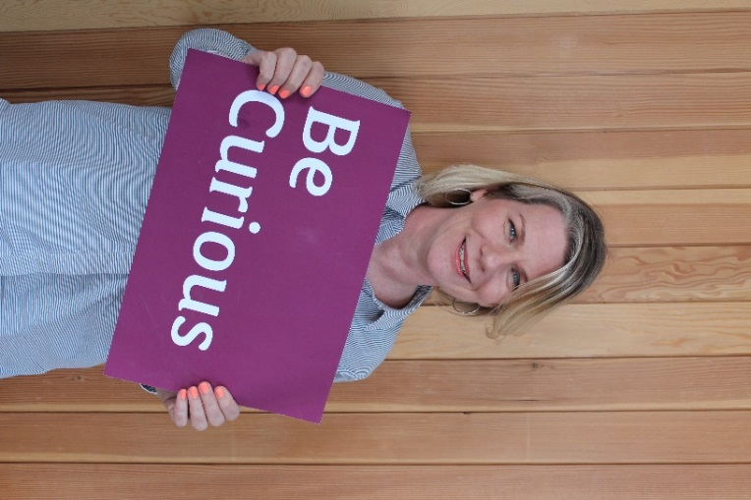
Careers and Employability Service

Slide 53
What’s on this Autumn
Book your place at stirling.targetconnect.net
 | November
1st | Saltire Application session | 4-5pm
5th | Step into teaching | 5-6.30pm
6th | Personal branding | 1-2pm
7th | International student opportunities | 1-2pm
8th | Postgraduate study | 4-5pm

Slide 54

Do you need specific careers advice? Booking a 1-1 appointment may be the support you need. (CV checks, mock interviews, careers guidance, etc.) https://stirling.targetconnect.net/ home.html
One to one Careers Appointments:
Our team of professionally qualified staff are here to offer confidential, one-to-one guidance about any issue relating to careers.
Quick Queries: 15min appointments available Mon- Friday. Book online through Target Connect (https://stirling.targetconnect.net/home.html).
Guidance: 1 hour appointments available, book through the Hub (ask@stir.ac.uk)
Focused Natural Science appointments are run on a Wednesday, but students can book to speak to another Career Consultant at any other time.
FOREVER!

Slide 55

Career Cafes
Wednesdays 12-2pm Underground
Notes:
Wednesdays 12-2pm Underground

Slide 56






Connect with us
stir.ac.uk/careers
StirlingUniCareers
StirlingUniCareers
@StirUniCareers
ask@stir.ac.uk
https://canvas.stir.ac.uk/enroll/P4XBB8

